Slide 1
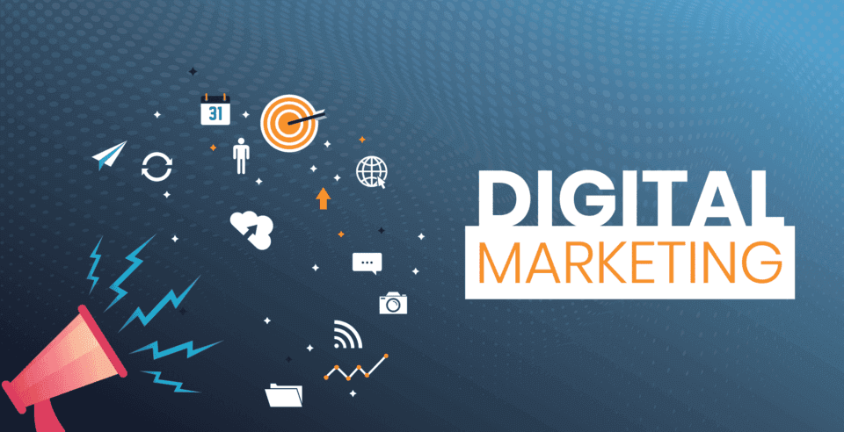

Slide 2
Digital Marketing
Digital Marketing is an umbrella term for the marketing of products or services using digital technologies, mainly on the Internet, but also including mobile phones, display advertising and any other digital medium.

Slide 3





Digital Marketing Outreach
Reach the right audience
Maximum Engagement with audience
Maximize Promotion and Customer Engagement
Motivate your audience and take action
Maximize return on your investment

Slide 4
Digital Marketing Consists:-
BRANDING
DIGITAL
MARKETING
SOCIAL MEDIA
FEEDBACK
INCORPORATION
CONTENT CREATION
EMAIL MARKETING
WEB
DESIGN
CUSTOMER
ENGAGEMENT
Photo
VIDEO PRODUCTION

Slide 5
Digital Marketing Process Flow

Slide 6








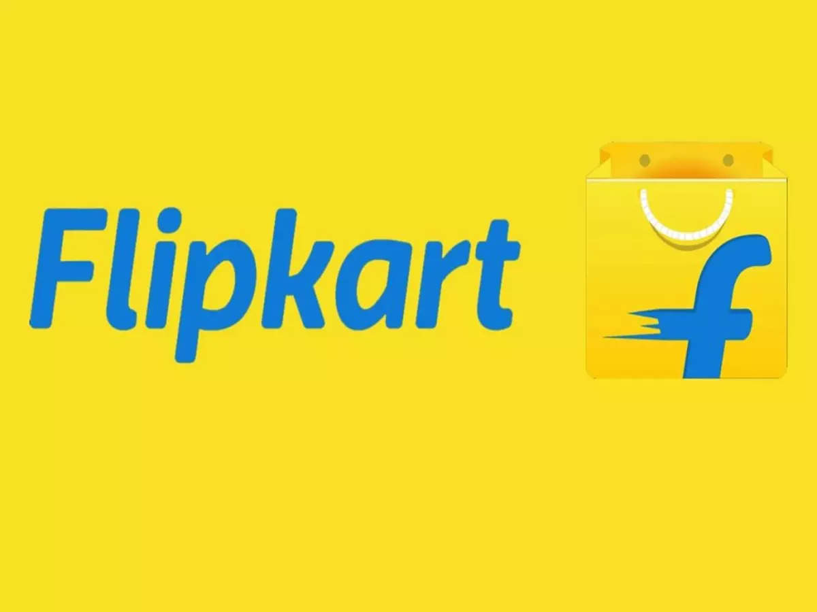





Social
Media
Organic content: Photo’s, videos, reels
Paid Content: Instagram ads, stories ads, influencer marketing
Shopping tools: Shop tab, product tab and catalog, live shopping etc.
Increased Customer Reach
SHG with a product
Content: Photo’s, videos, Content with product Description through chat groups (Direct User Interaction)
e-Market Platform
Order through DM’s/ associated websites
Engage Logistic Partner for pickup and delivery of product
Maximize Reach
Increased Profits
Prepaid Orders: Online payment through payment gateways, UPI, wallets etc.
Post Paid Orders: Cash on Delivery (COD)
Order through e-Market Platform
Direct
Procurement
Logistics Partners engaged by the eMarketing Platforms

Slide 7

Instagram Marketing
> 200 Cr
Promote Business
Optimize Instagram profile for business
Create a consistent brand image
Set clear, achievable objectives
Develop a content strategy
Interact with your followers
Cross promote
Use trending hashtags
Track your progress
The no. of active users on Instagram
64 %
Percentage of users below 34 years of age
Easy Access with a smart phone
Instagram is a visual platform. It is important to entice people/ potential consumers with images, videos along with attractive product description
50 Cr
The number of daily Instagram users

Slide 8
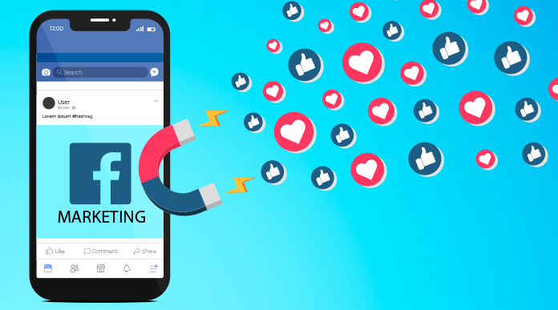
Facebook Marketing
Requires a Smart Phone for Operating
Procedure for Operating are as under:-
Create Facebook Profile
Create Facebook Business Page
Verify Business Page
Log-in Facebook Market Place
Create Listing
Join targeted Facebook Groups
Publish Products
Start Selling
Tie- up with a Logistic Partner for Pick-up and Delivery
Facebook Marketing incorporated:-
Organic text, photo, or video content
Paid, or “boosted,” text, photo, or video content
Facebook Stories and Reels
Facebook ads
Facebook Groups
Contests and giveaways
Facebook Messenger chatbots or auto-responders
Influencer marketing campaigns
Facebook Shops
Facebook Live video streams
Facebook marketing is the strategic promotion of a business or brand using the Facebook platform.
It can enhance brand recognition, expand your online audience, capture potential leads, and boost sales of products or services.

Slide 9
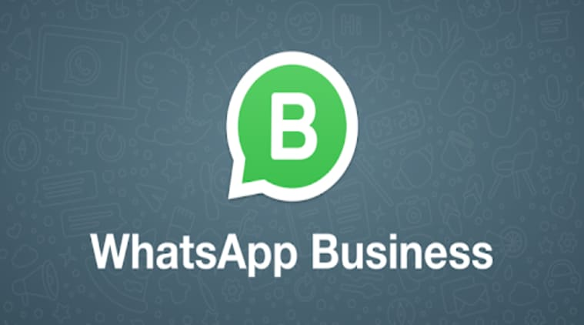

WhatsApp Marketing
Better Relationship with the Customer
Higher Conversation
Better Sales
The WhatsApp Business is easily Operated using a smart phone
Lower Cost of Marketing

Slide 10
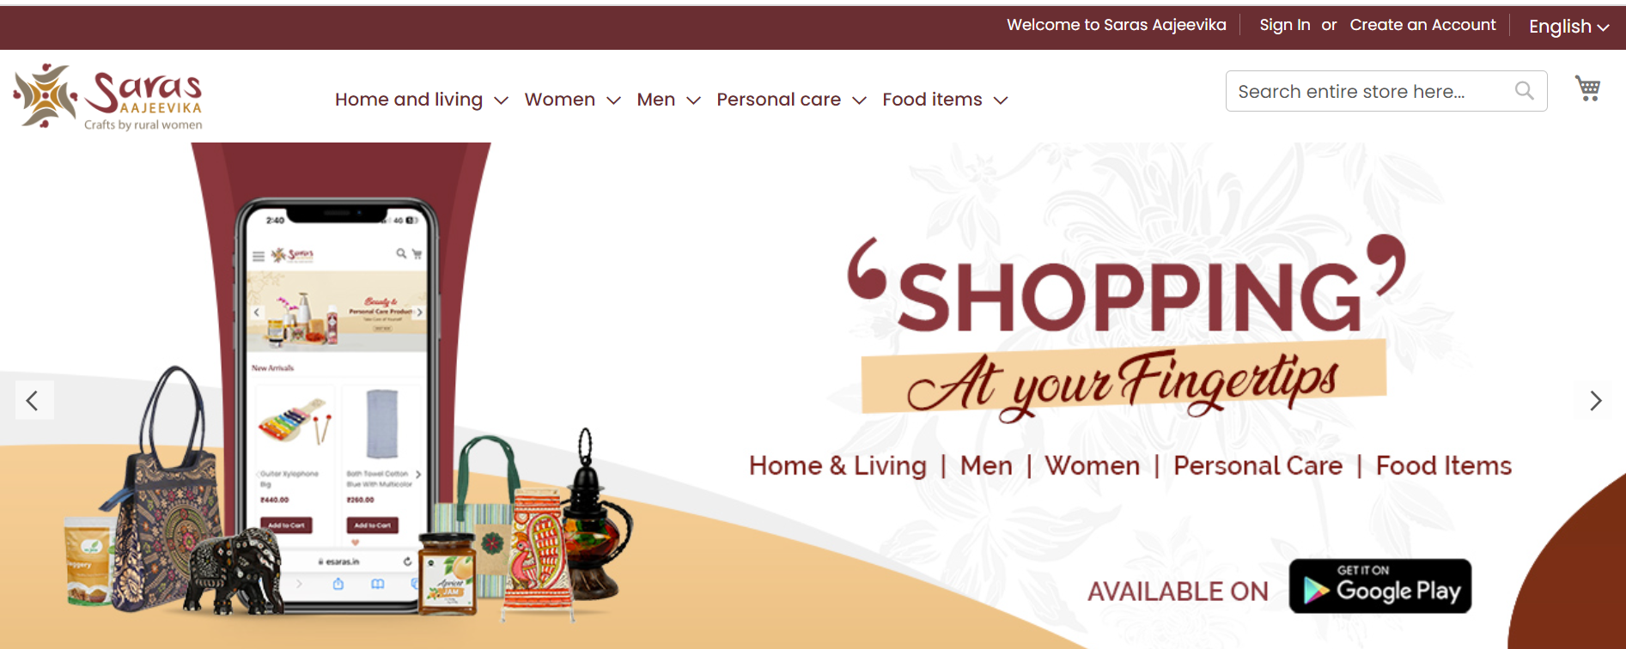
www.esaras.in - dedicated e-Commerce Platform for SHG products
eSARAS is an efficient and effective online platform that has been developed for the enhancement of the livelihood of the rural people. This online platform showcases the products made by self-managed Self Help Groups (SHGs) and federated institutions.
The mission is to curate authentic handcrafted products from across the country. The artisans get remunerated fairly with no middlemen to manipulate prices. Through this online portal, customers get access to 100% authentic handcrafted products emerging straight from the heart of India.
Also, the core motive is to make sure the handicraft industry in India gets a digital boost. With the initiative of National Rural Livelihoods Mission (NRLM), Ministry of Rural Development (MoRD), Government of India an efficient and effective online platform has been developed for the enhancement of the livelihood of the rural people. This online platform showcases the products made by self-managed Self Help Groups (SHGs) and federated institutions.

Slide 11
Amazon, Flipkart and Meesho: Alliance with Private e-commerce platforms for marketing of SHG products across India
Since May 12, 2022
Enabling eligible SHGs and SHG women entrepreneurs to list their products and develop business on Amazon.in,
Onboarding, marketing and promotion
Training and account management support
Initial imaging and cataloging support
NRLM dedicated storefront under the Saras Aajeevika brand name (saras_aajeevika at www.amazon.in or https://www.amazon.in/b/?node=66060047031)
Since February 13, 2022.
Support increasing business and trade inclusion opportunities
Conducting in-person trainings on Seller Account creation, cataloging process, marketing & business.
Saras Aajeevika storefront
Saras Aajeevika brand as the national umbrella brand including state brands as sub-brands.
State and national level reports
Referal fees elimination initially.
Since November 02, 2021.
Onboarding and marketing of SHG products : Flipkart Samarth
Incubation support, trainings.
Account Manager, Imaging and product cataloguing support
Referal fees optimisation.

Slide 12
Benefits of Digital Marketing
Time and Effort Saving
Economical
Flexibility
Digital Marketing
Impactful
Real Time Analysis
Instant Feedback

Slide 13
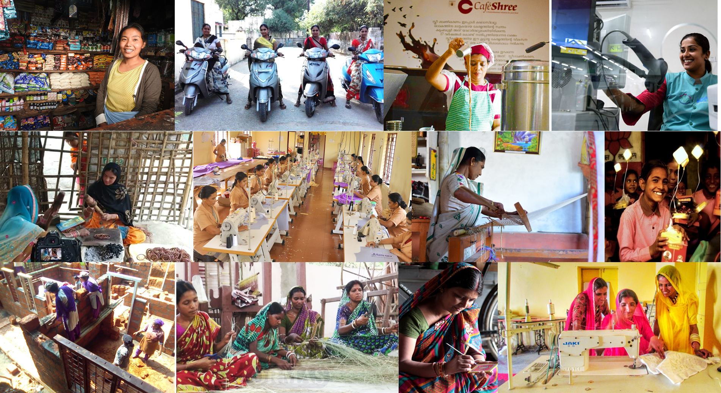
THANK YOU

